Slide 1

Data Analysis Basics
Patrick Mathias
Lab Medicine Core
Please fill out pre-course survey!

Slide 2
Lesson Goals
Construct a data request in a format that can be easily interpreted by a data analyst, by including the required data elements/fields and inclusion/exclusion criteria
Identify common problems associated with real world laboratory data (e.g., censoring, keystroke errors, missing values, varied formats) and methods to mitigate them
Lesson Objectives
Describe the 3 principles of tidy data
List at least 2 best practices to adhere to when generating your own data
Notes:
In this first session our goal is to develop some familiarity with the R programming language.
We will also discuss the important role of reproducible data analysis and how R can help us with this.

Slide 3
What is Data Analytics?
Notes:
Without further ado, let’s dive in!!
Getting Started with RStudio.

Slide 4
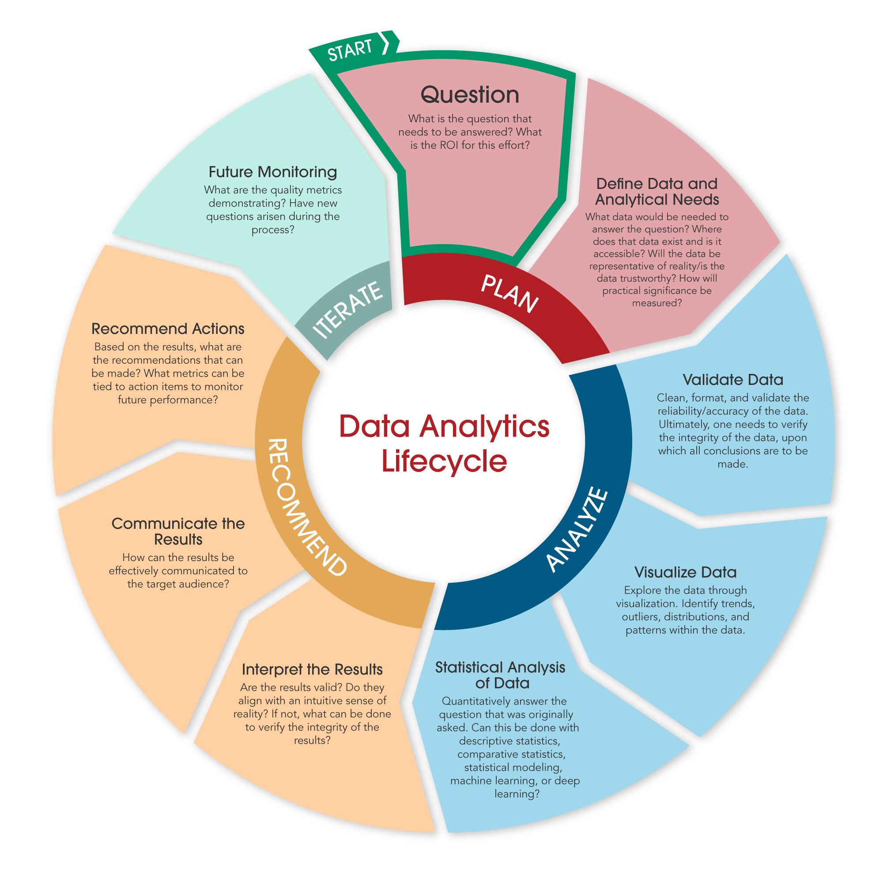
What is Data Analytics?
Data analytics includes discovering useful information and conclusions to support decision making from data
Using real-world data
Visualization
Statistical and exploratory analysis
Machine learning
Communicating results

Slide 5




Data Analytics Can be Categorized By How the Data is Applied
Descriptive
Diagnostic
Predictive
Prescriptive
What is happening?
Right now
Recent past
Why is it happening?
What are the root causes?
What will happen?
When might it happen?
What should we do?
Integrate what we think will happen with what has happened

Slide 6
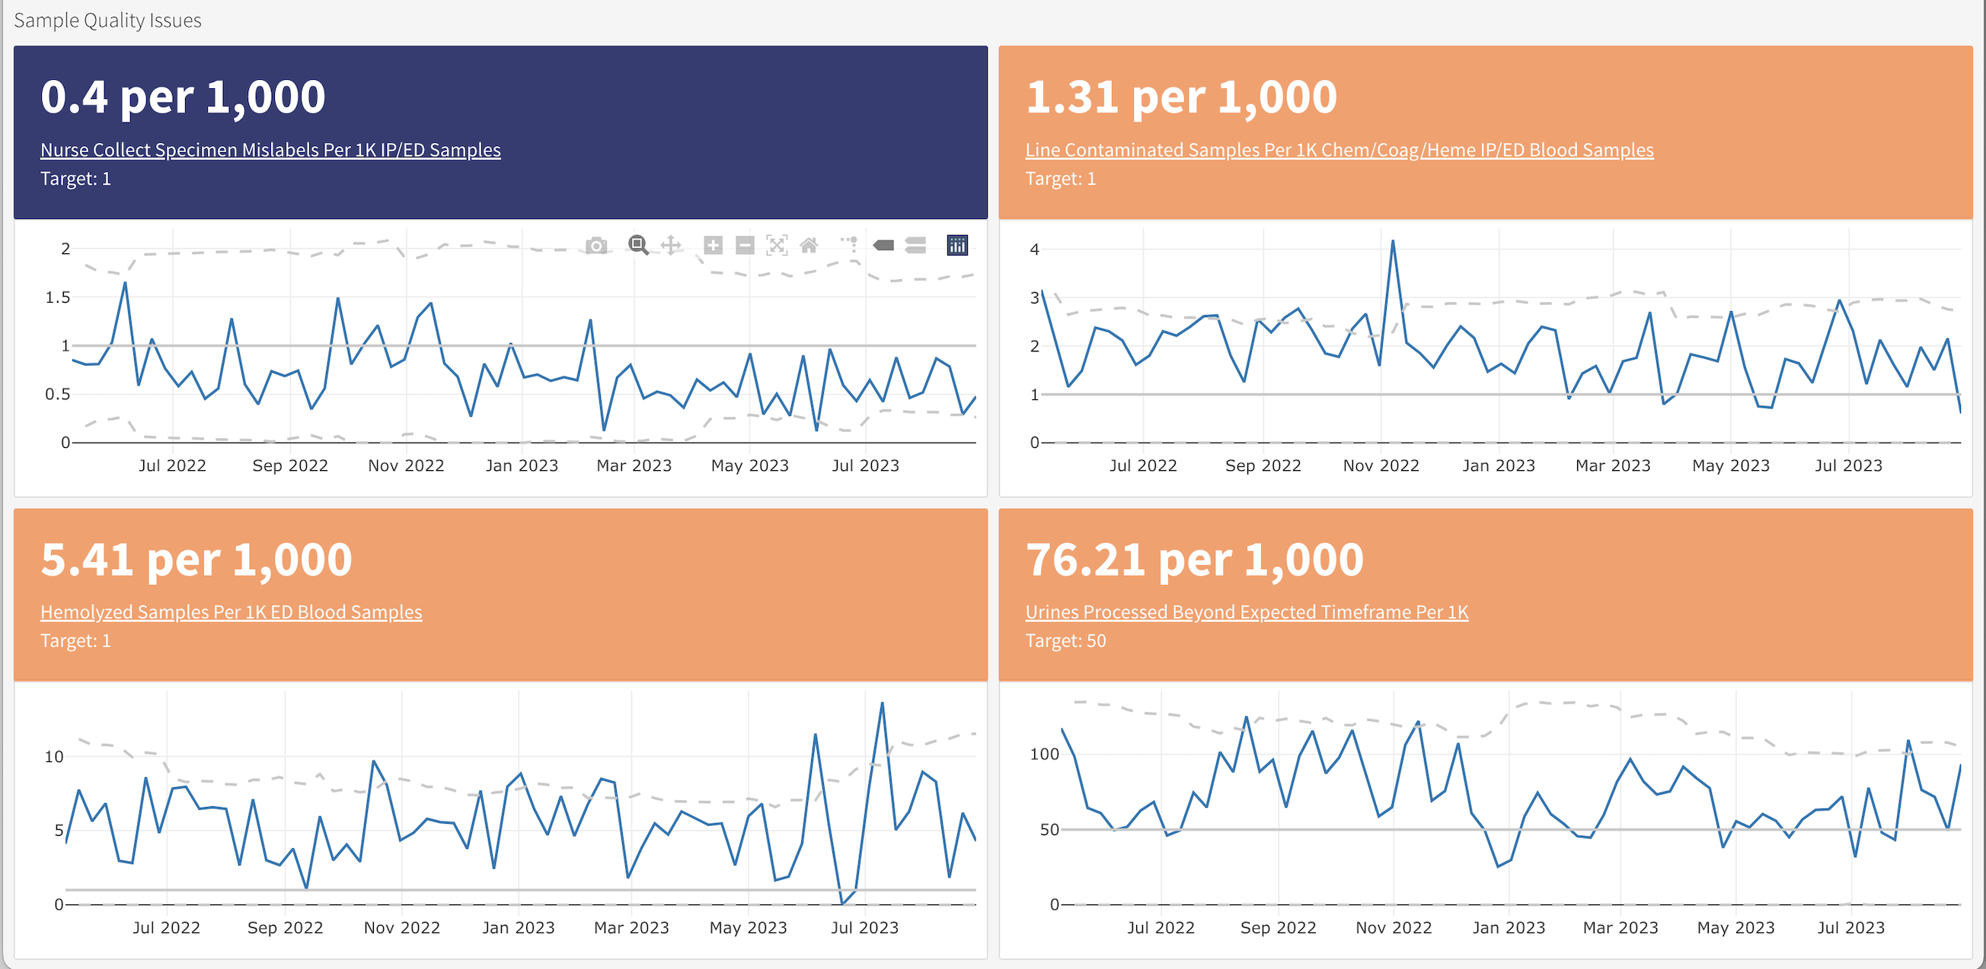
Descriptive Analytics Are Becoming More Common Across Healthcare Settings
DLMP Quality Assurance Dashboard

Slide 7
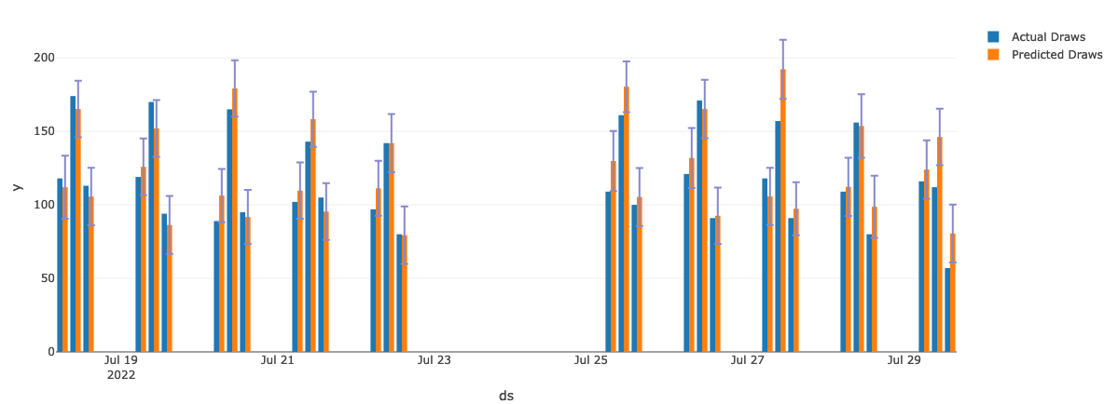
Predictive Analytics Are Emerging In Multiple Domains
UWMC Phlebotomy Prediction

Slide 8
What is the Role of the Laboratorian in Analytics?
Define the important problems to solve and/or questions to answer
Subject matter expert: those generating the data best understand the data
Perform and interpret routine analyses (e.g. quality control)
Support the validation of analyses done by others
Develop and/or perform new analyses for quality improvement

Slide 9
Why should we care about reproducibility?
Notes:
Without further ado, let’s dive in!!
Getting Started with RStudio.

Slide 10
18
The Duke Cancer Scandal
Chemo sensitivity from microarrays
Errors first, then cover-up
Clinical trials based on flawed models
Papers retracted, lawsuits settled
Notes:
To highlight the importance of reproducibility, let’s consider the following case.
In the mid-2000s, two researchers at Duke University tried to use microarray gene expression data of tumor cells to predict sensitivity to chemotherapeutic agents. This approach generated a lot of excitement at the time, and the resulting work was published in high-profile journals including Nature Medicine, JAMA, and the New England Journal.
(**) Unfortunately, there were a number of serious errors in the data analysis. The media has focused on the fact that the researchers tried to cover up investigations into these errors and press on towards clinical trials even though there were at the time open questions about the validity of the methods.
(**) Even more unfortunately, patients were enrolled in clinical trials and allocated based on flawed models, and in all likelihood patients were actually allocated to incorrect treatment arms.
(**) In the end, 18 papers were retracted, and Duke settled more than 10 lawsuits for an undisclosed amount of money.

Slide 11
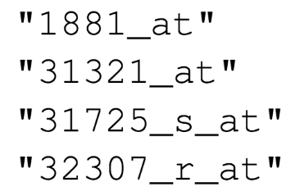
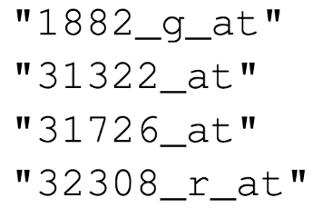

Duke
MD Anderson
Off-by-one indexing error
Notes:
Keith Baggerly and Kevin Coombes, biostatisticians at MD Anderson uncovered the mistakes that led to these retractions, in painstaking work. Let’s look at one of the errors they found.
These are a few of the hundreds of microarray probe sets – each corresponds to a gene – that the Duke investigators reported to predict sensitivity to 5-fluorouracil.
(**) And here are the probe sets that the MD Anderson team got. You can see that those two are different.
(**) If I highlight the last number of each probe, you might notice a pattern: the number of the probe set that Duke reported is exactly one less than the number of the probe that MD Anderson found when they re-did the analysis.
(**) This is what’s called a off-by-one indexing error and is what happens when you use a tool like Excel and accidentally delete one cell. The result is that all the values in the affected column are shifted by one. This is a simple error to make, but as you might imagine, this error invalidates all downstream results.

Slide 12
“Common problems are simple…
Off-by-one indexing error
Sensitive / resistant label reversal
Confounding in experimental design
Inclusion of data from non-reported sources
Wrong figure shown
… and simple problems are common.”
Highly recommended Keith Baggerly lecture: https://bit.ly/duke_scandal
Notes:
The off-by-one indexing error was just one of many simple errors the MD Anderson team discovered.
(**) Another type of error that was pervasive in the study was label reversal so that cell lines were labeled sensitive to a drug when they actually were resistant, and vice versa. That type of error can lead to a scenario where a patient gets the chemotherapy that would be predicted to be least beneficial.
(**) Other problems they identified were confounding, (**) inclusion of data from sources that were not reported in the paper, (**) and wrong figure shown.
These are all simple errors – you don’t have to be incompetent or negligent to make them. (**) Because these errors are so easy to make and because without good documentation or a reproducible workflow it’s hard to catch them, they are also very common.

Slide 13
Point-and-click is not inherently reproducible
Computer code can precisely document each step of the analysis
Notes:
A key issue in this case study is that the investigators used “point and click” tools like Excel.
This prevented peers and independent investigators from catching errors in the analysis, until it was too late.
And the Duke case study is only one example where the critical barrier to reproducibility was the tendency of investigators to use graphical user interface “point-and-click” type tools. These interactive tools usually don’t record user actions and because of this, they are fundamentally not reproducible.

Slide 14
Reproducibility can be achieved when the following criteria are met
All methods are fully reported
All data and files used for the analysis are available
The process of analyzing raw data is well reported and preserved
Same data + Same script = Same results
https://www.r-bloggers.com/2016/06/what-is-reproducible-research/

Slide 15
Why YOU should analyze your data reproducibly
“Can we redo the analysis with this month’s data?”
“Why do the data in Table 1 not seem to agree with Figure 2?”
“Why did I decide to omit these six samples from my analysis?”
Your closest collaborator is You from 6 months ago
Notes:
But reproducibility doesn’t only help others. Consider the following 3 statements and ask yourself if they sound familiar.
-Can we redo the analysis with this month’s data?
-Why do the data in Table 1 not seem to agree with Figure 2?
-Why did I decide to omit these six samples from my analysis?
**Your closest collaborator is you from 6 months ago. You can do yourself a huge favor by using tools that promote reproducibility.
And if you are analyzing clinical data and might affect patient management or public health based on your findings, that makes it so much more important that you take steps to assure your analysis is documented, free of errors, and reproducible by others.

Slide 16
Principles of TIDY Data
Notes:
So now that you've met us let's discuss for a moment how this workshop is going to work

Slide 17
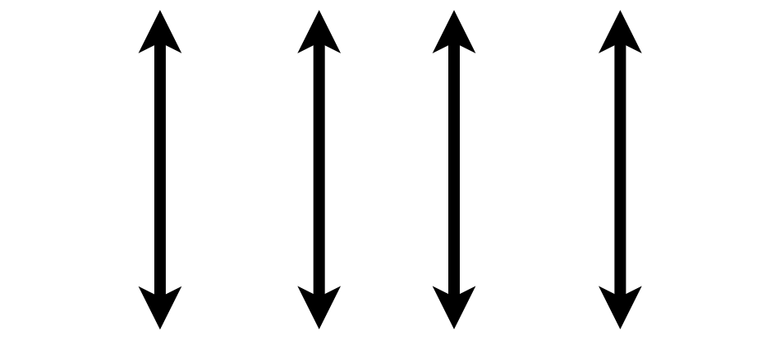

Tidy Data Summarized
A data set is tidy if:
Each variable is in its own column
Each observation is in its own row
Each value is in its own cell
MRN
Wickham, H. . (2014). Tidy Data. Journal of Statistical Software, 59(10), 1–23.

Slide 18
Consider a single data set with 4 variables
country
year
population
cases
Public health data set intended to represent the cases of a disease in a population by country and year

Slide 19
Representation 1
## # A tibble: 12 x 4 ## country year type count ## <chr> <int> <chr> <int> ## 1 Afghanistan 1999 cases 745 ## 2 Afghanistan 1999 population 19987071 ## 3 Afghanistan 2000 cases 2666 ## 4 Afghanistan 2000 population 20595360 ## 5 Brazil 1999 cases 37737 ## 6 Brazil 1999 population 172006362 ## 7 Brazil 2000 cases 80488 ## 8 Brazil 2000 population 174504898 ## 9 China 1999 cases 212258 ## 10 China 1999 population 1272915272 ## 11 China 2000 cases 213766 ## 12 China 2000 population 1280428583

Slide 20
Representation 2
## # A tibble: 6 x 3 ## country year rate ## * <chr> <int> <chr> ## 1 Afghanistan 1999 745/19987071 ## 2 Afghanistan 2000 2666/20595360 ## 3 Brazil 1999 37737/172006362 ## 4 Brazil 2000 80488/174504898 ## 5 China 1999 212258/1272915272 ## 6 China 2000 213766/1280428583

Slide 21
Representation 3 is Tidy
## # A tibble: 6 x 4 ## country year cases population ## <chr> <int> <int> <int> ## 1 Afghanistan 1999 745 19987071 ## 2 Afghanistan 2000 2666 20595360 ## 3 Brazil 1999 37737 172006362 ## 4 Brazil 2000 80488 174504898 ## 5 China 1999 212258 1272915272 ## 6 China 2000 213766 1280428583

Slide 22
Why keep things tidy?
Consistent mental model for data = common data manipulation becomes easier
Many tools in R (and Excel + other languages) make it very easy to do sophisticated analysis and visualization with tidy data
Databases that store data from clinical information systems often already represent data in a tidy form

Slide 23
Tidy Data Summarized
A data set is tidy if:
Each variable is in its own column
Each observation is in its own row
Each value is in its own cell
MRN
Wickham, H. . (2014). Tidy Data. Journal of Statistical Software, 59(10), 1–23.

Slide 24
Requesting Data

Slide 25
Apply the Tidy Data Framework When Requesting Data
Consider which variables (data elements) you will need for your data request
Then determine how a data analyst will know which observations will be included
Inclusion criteria – how will you go from a whole population to a subpopulation?
Common criteria: specific orders, specific test values, age range, set of locations
Lab data often already stored in a tidy data format

Slide 26
Data Need
No
Research?
Yes
Operational/QI Request Form
Yes
Blanket IRB?
No
Review by Blanket IRB PI
Review by Compliance Officer
DLMP Analytics
Review by RTS Director
RTS Request Form

Slide 27
Operational Data Requests
https://bit.ly/dlmp-ops-data
Must attest that the data will not be used for research purposes – but can be converted into blanket IRB
Short description of project
Short description of requested data – list of common variables at https://kb.labmed.uw.edu/display/HOME/Data+Dictionary+for+Data+Requests

Slide 28
Research Requests Under Blanket IRB
Blanket IRB is used for studies not funded by an external grant that are retrospective in nature and only require data from electronic systems
Requests can be made through operational request form – but make a note that there is intent to use the blanket IRB
Training and sign off on blanket IRB access is required
When specific charts are reviewed as part of the research, this should be recorded on the Accounting of Disclosures form and submitted

Slide 29
Other Research Requests
Other research requests that are focused on lab/path data can be submitted to Research Testing Services: https://redcap.link/DLMPResearchDataRequestForm
For studies that have their own IRB – typically externally funded studies or those that have requirements beyond data
Review ensures that the scope of data requested aligns with the IRB documentation

Slide 30
Tips for Generating Your Own Data

Slide 31
Building your own data set
Data analysis projects beyond a certain complexity require creating your own variables or data frames (tables/spreadsheets)
In addition to building tidy data sets, consider steps to make future analysis easier

Slide 32
Naming Variables
Use variable (column) names that are easy for someone not performing your analysis to understand
“result_value” as opposed to “x”
“collection_time” instead of “time”
Stick to naming that will make it easier for a computer to read the data
Avoid spaces in names: “result_value” instead of “result value” (space has meaning in languages like R)
All lowercase (or uppercase) will be easier for you to type, even if it is not easier for the computer to parse

Slide 33
Respect Data Types When Creating Variables
Variable inspection and summarization is much easier (and less error prone) if known data types are used
run_id | value
1 | 5
2 | cancelled
3 | 11
4 | < 2
5 | 4
run_id | value | comment
1 | 5
2 |  | cancelled
3 | 11
4 |  | < 2
5 | 4

Slide 34
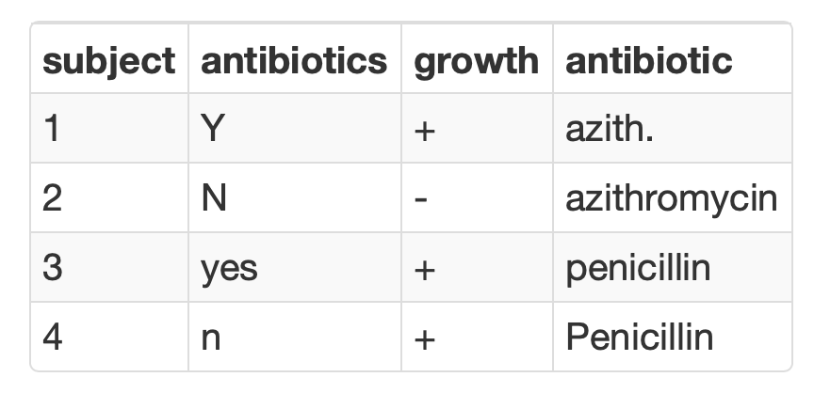
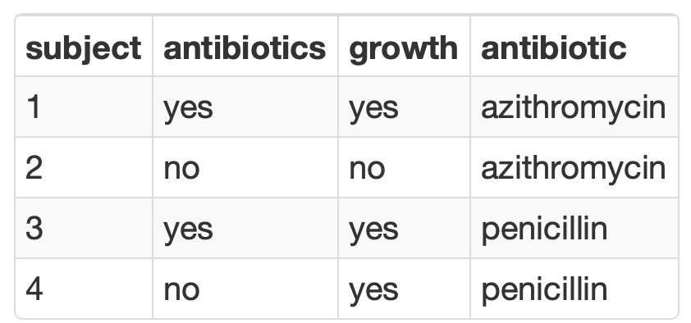
Consistency is Critical for Analyzing Categorical Variables
Summarization is seamless when consistent values are used to represent binary or categorical variables

Slide 35
Use Standard Formats for Dates and Times
Learn to know and love the ISO 8601 standard for representing dates and times
Prevent ambiguity when interpreting and parsing
Dates in filenames sort chronologically
Excel unfortunately does not encourage the use of this format (but should parse it without a problem)
Obligatory xkcd (https://xkcd.com/1179/)

Slide 36
Securing Your Data

Slide 37
UW Medicine Privacy, Confidentiality, and Information Security Agreement
All UW Medicine workforce members (including faculty, employees, trainees, volunteers, and other persons who perform work for UW Medicine) are personally responsible for ensuring the privacy and security of all patient, confidential, restricted, research data, student information or proprietary information to which they are given access (referred to throughout this document as protected information).

Slide 38
Keep protected information confidential
PCISA: I will maintain the confidentiality of all protected information that I have access to.
Protected (health) information = personally identifiable information + health information
Best practice: assume all info is protected unless proven otherwise!
Name | Address (< state) | Dates (birth, service, etc.) < year*
Telephone numbers | Fax numbers | Email addresses
Soc sec number | MRN | Health plan number
Account numbers | License or cert. number | Vehicle identifiers
Device identifiers | Web URLs | IP addresses
Finger/voiceprints & recordings | Photographs | Any other unique ID
*No age in years if > 89

Slide 39
Only access systems as necessary to do your job
PCISA: I will only access UW Medicine clinical systems to perform my authorized job duties and will only use my own usernames and passwords. I am accountable for all accesses made under my login and password.
Authorization required to access PHI of family members (OK to access own PHI)
Don’t forward protected info to unapproved email domains: https://depts.washington.edu/uwmedsec/restricted/guidance/encryption/approved-email-domains/
Fred Hutch, Bloodworks NW, most (but not all) regional reference lab clients/local health systems
Secure email portal available when communication with outside entity that includes PHI is required

Slide 40
Use the necessary technical tools to protect data
PCISA: I will store all protected information on secured systems, encrypted mobile devices, approved third party applications or other secure media.
PCISA: I will ensure that my personally-owned computing devices are secured according to UW Medicine’s information security requirements before using them to perform UW Medicine business operations.
Use DLMP provided workstations, laptops, and computing resources for work activities
Password protect and encrypt any personal devices that may hold PHI
Connect to VPN when completing work activities, especially remotely
labmedhelp@uw.edu for help with encryption of a personal device

Slide 41
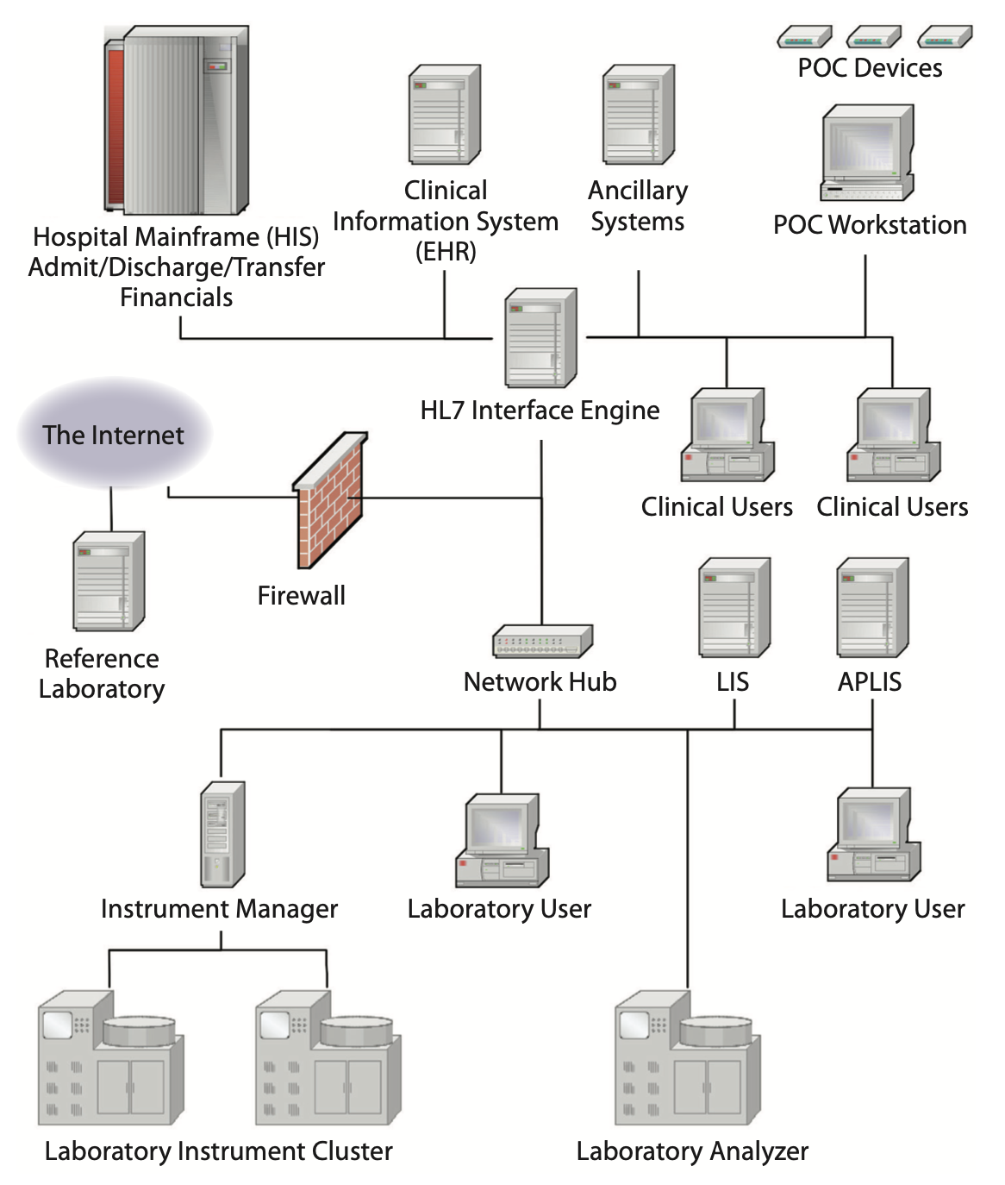
Network Security
Firewalls and routers restrict network traffic
Barrier between computer or network and outside
Barriers between network segments (partitions)
Diverse data travels on network
Encrypted communications from trusted clients can access network through virtual private network (VPN)

Slide 42
Only use approved cloud resources
UW Medicine must have a business associates agreement (BAA) in place with any non health care organization (non covered entity) that is managing/storing PHI
BAA is in place with:
Microsoft (Office 365, Teams, Azure)
Amazon (Amazon Web Services)
Coordinate with DLMP informatics for any planned use of cloud infrastructure outside of Office 365 & Teams
No BAA in place with Google (upper campus phasing out some but not all services)
Be cautious with all external web resources

Slide 43
Use the necessary technical tools to protect data
PCISA: I will not change my computer configuration or perform any action that might circumvent authentication or security on any UW Medicine system without prior approval.
PCISA: I will use only licensed and authorized software; I will not download, install or run unlicensed or unauthorized software.
Workstations by default do not include administrative privileges
Send software requests to labmedhelp@uw.edu
DLMP has scientific computing resources for data analysis activities, including RStudio which is accessible via web browser

Slide 44
R Course Introduction
Notes:
I'm here just to give you a quick introduction after which we'll dive right into the meat of the workshop.

Slide 45
Course Goals and Objectives
Establish good practices for working with data safely
Teach features of the R programming language that improve reproducibility in clinical data analysis
Demonstrate how R can be used to perform analyses of laboratory operational data
Establish a basis of understanding in the 'tidy' approach to data analysis
Notes:
Obviously we would love for those who are here today to all walk away and just start coding but the reality is that while that would be great we also have a set of more modest if more important goals
We're here to Advocate for the use of R as a means of improving reproducibility in clinical data analysis and I cannot emphasize enough how strongly we feel about this point
As we review this we will demonstrate how we can use R perform analyses of laboratory operational data
And we also hope to establish a baseline understanding of what tidy data is and how to implement a 'tidy' approach to data analysis within the framework of R

Slide 46
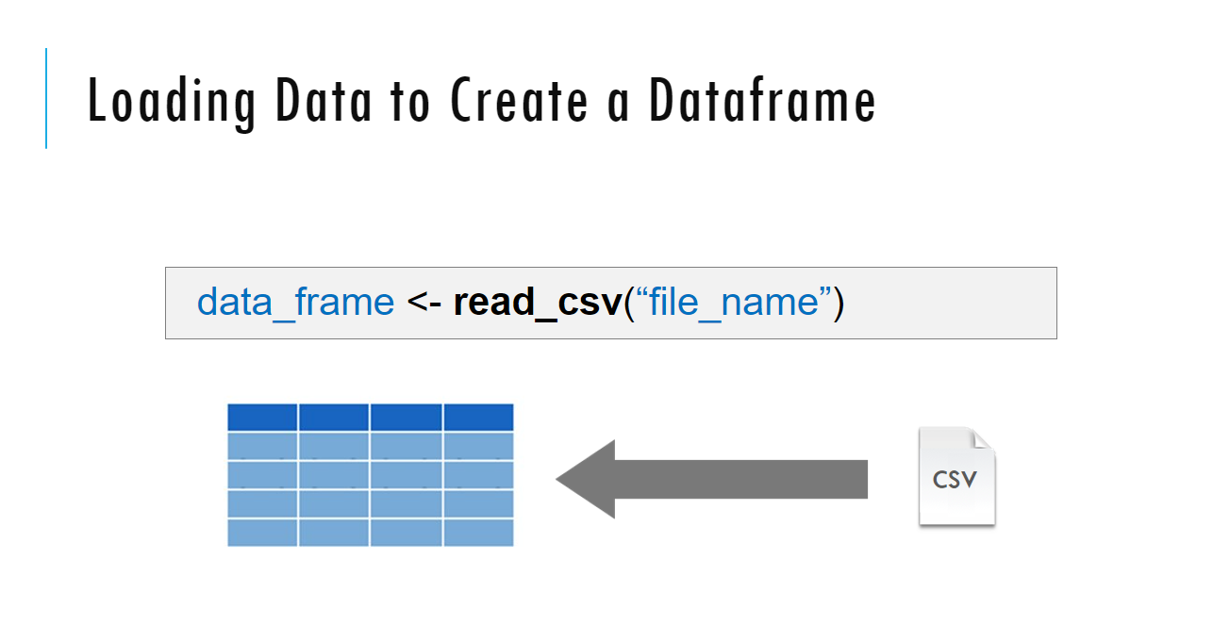
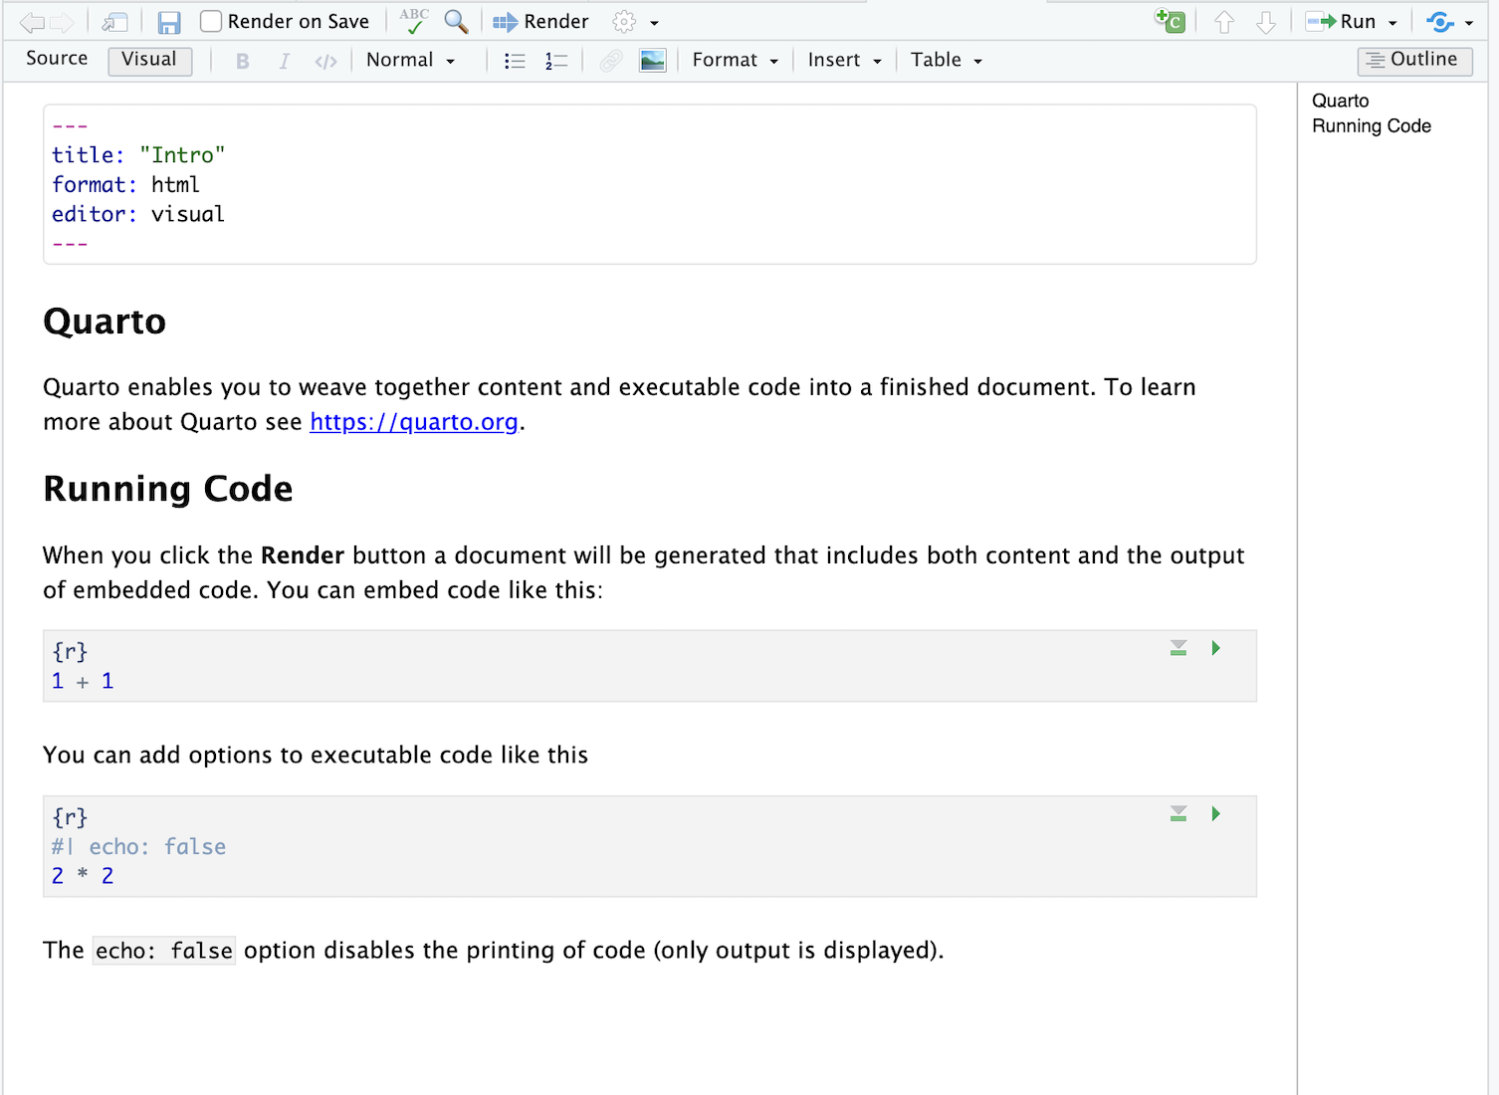
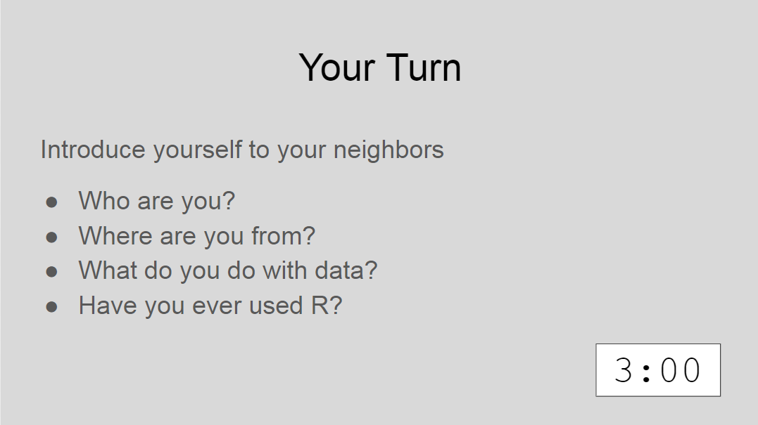
Sessions
Notes:
The meat of the workshop are the sessions each of which will cover discrete subjects or components of R in a data analysis. The sessions have a powerpoint associated with it as well as an R script.
We'll be describing a specific function or topic in the context of the powerpoint – all of which are included in the coursebook and available for download. The same code that is being demoed is included in the R script and you are invited to follow along, run the code, play with it if you like.
At several points in the session we'll have you engage in some exercises which we call Your Turns. In a Your Turn we'll assess how we're doing by asking you to critically think about the topic in the session and respond to a question or do some coding on your own. We'll speak a bit later about how these coding exercises will work.

Slide 47
Tips for learning
Cheatsheets show how to do common things – orient yourself with them early
The best way to learn to code is by doing
Practice is key!
Programming is hard, even for those with a lot of experience. Find resources and ask for help!
Notes:
And just some final words before we begin, no matter what you're learning but particularly coding, the best way to learn is by doing:
Find a project, make a goal for yourself, push yourself to use R, it's OK to lean on some excel, we all do when we're starting out, but try to get that activation energy to get your hands typing code. We would not be teaching this course if we didn't strongly believe that R is accessible to all of you. So keep practicing and you'll get there.
With that let's get started with the workshop. Up next Joe will provide us with the basics of R and get us up and running with Rstudio Cloud.

Slide 48
Onward!
We will sign onto our DLMP server to use Rstudio for these lessons: https://rstudio.dlmp.uw.edu/
This resource will be available for you while you are at UW
It is secure for protected health information (but be careful about where you transfer PHI to get it to the RStudio server)
Course material available at: https://github.com/pcmathias/dlmp-data-analysis-with-r
Please fill out pre-course survey: https://forms.gle/TEMDjnKQUrxN9Egr8

Slide 49
Lesson Goals
Construct a data request in a format that can be easily interpreted by a data analyst, by including the required data elements/fields and inclusion/exclusion criteria
Identify common problems associated with real world laboratory data (e.g., censoring, keystroke errors, missing values, varied formats) and methods to mitigate them
Lesson Objectives
Describe the 3 principles of tidy data
List at least 2 best practices to adhere to when generating your own data
Notes:
In this first session our goal is to develop some familiarity with the R programming language.
We will also discuss the important role of reproducible data analysis and how R can help us with this.

